Slide 1
Building Shiny Web Apps with Typescript and Angular
Dustin Ewers
Consultant @ Centare
Website: www.dustinewers.com
LinkedIn: www.linkedin.com/in/dustinewers
Twitter: @dustinjewers
Demos & Slides: https://github.com/DustinEwers/shiny-angular-demos
Notes:
Slide background from: www.subtlepatterns.com

Slide 2
Roadmap
History
Basics
Demos

Slide 3
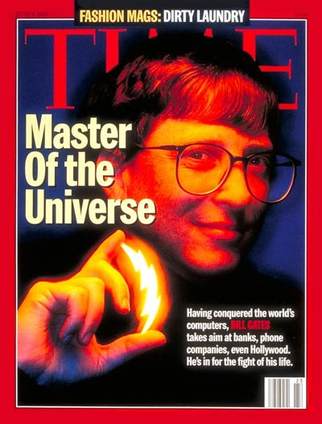



1995
Notes:
http://www.vogue.com/article/pop-culture-1995
1995 was a big year…
Windows 95 – Gates = Dark Lord of the Sith
Toy Story – First Computer Animated Movie
Amazon.com – First Book
Macarena

Slide 4

JavaScript
Sun | Mon | Tues | Wed | Thurs | Fri | Sat
 | 1 | 2 | 3 | 4 | 5 | 6
7 | 8 | 9 | 10 | 11 | 12 | 13
14 | 15 | 16 | 17 | 18 | 19 | 20
21 | 22 | 23 | 24 | 25 | 26 | 27
28 | 29 | 30 | 31
Notes:
Invented by Brendan Eich in 10 freaking days!

Slide 5

2005
Notes:
Popularized in apps likes gmail
Allowed for desktop-like web applications

Slide 6

2006
Notes:
Invented by John Resig
Used on at least 70% of sites on the web | vast majority
Smoothed out the idiosyncrasies of the web

Slide 7

2009
Notes:
Invented in 2009
Server side JS
You’re probably using it…
NPM | Command Line Tools | Cambrian Explosion

Slide 8

2010
Notes:
This is not the angular we’re talking about today

Slide 9

2016
Angular
(not Angular 2)
Notes:
Angular (Angular 2)
Released in 2016
Build by Google
Totally different than Angular JS (Angular 1)
Angular JS is to Angular like Java to JavaScript

Slide 10
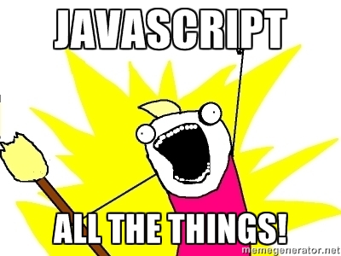
Notes:
Microcontrollers: Johnny-Five
Servers: Node.js
Command line tools: npm, gulp, etc...
Mobile Apps: Cordova, Ionic
Desktop applications: Electron
VR: Renderloop, Three.js
-----
Even Web Applications

Slide 11


Slide 12


Slide 13
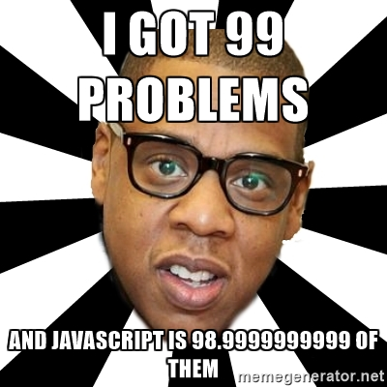
Notes:
Lack of modules
Lousy scope
Lack of a decent type system
Make JavaScript lousy for the large scale apps we want to build things in

Slide 14
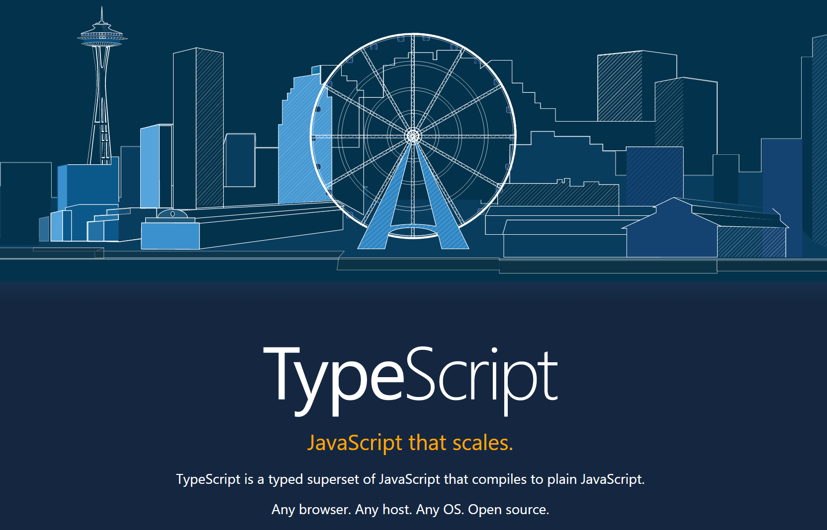
2012
Notes:
TypeScript solves these problems
Invented by Microsoft
Released in 2012 (after two years, not 10 days)

Slide 15
Why Typescript?
Modern JS
Future JS
Static Types
Notes:
Typescript tracks modern JS, future JS, and adds static types
Modern JS:
As good as the other top line transpilers
Classes, modules, etc…
Future JS:
Tracks new features from newer versions of JS
Static types:
Reduce errors, allow for greater tooling

Slide 16
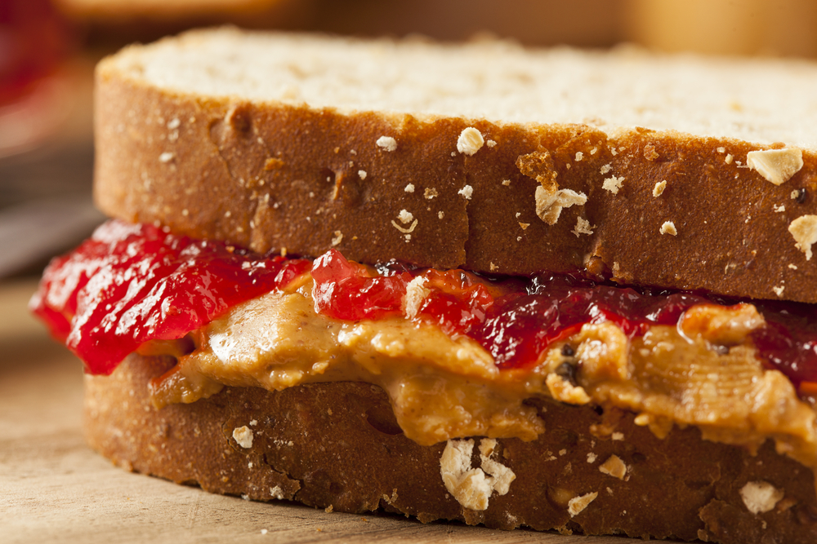
Notes:
What does Angular have to do with Typescript?
Angular and Typescript go together like PB&J

Slide 17
Why Angular?
Works Everywhere
Good Tooling
Excellent Performance
Notes:
https://angular.io/features.html
Can Build Desktop (Electron), Mobile (Ionic), and Web Apps
Great Visual Studio Support
Among the quickest client side framework

Slide 18
Why Angular?
Modular Code
Easy(ish) to Learn
Fully Featured
Notes:
https://angular.io/features.html
Great separation of concerns, built in DI, very testable
Far fewer directives than NG1, don’t need to learn a bunch of extra tools like React
Fully Featured. You don’t have to string together a ton of small tools.

Slide 19
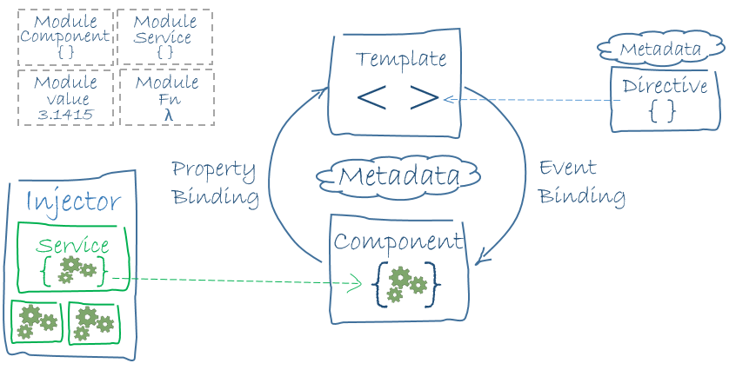
Notes:
https://angular.io/docs/ts/latest/guide/architecture.html
https://angular.io/docs/ts/latest/guide/cheatsheet.html
Angular 2 is an HTML Compiler -> You bind special html and JS together.
At the Core is Components – which are bound to Templates
Services provide cross cutting functionality
Directives and Pipes - provide some additional functionality to templates

Slide 20
Alternatives?
React
Ember
Others
Notes:
React is a framework, but it’s more of a legos approach than Angular’s kitchen sink approach
Angular copied a lot of concepts in React
Lots of tool choices, so easy to get into JS fatigue
Ember
Seems to be more popular in the Ruby community
Very opinionated
Others
There’s a new flavor every week. Don’t bother unless it hits critical mass or provides something new
Vue.js, Meteor, Sails, etc…

Slide 21

Tooling

Slide 22
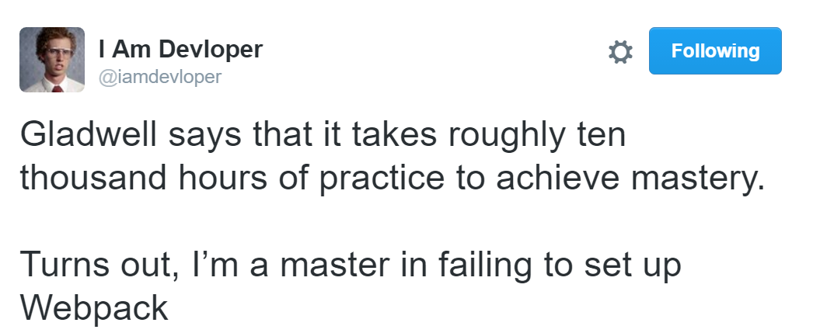
Webpack
Notes:
Version 2, really nice….

Slide 23

Angular CLI
Notes:
CLI tools to easily setup and serve Angular applications

Slide 24
Demos

